Slide 1
Automatic speech Recognition For Telugu
Team 22
Prerna Rohatgi
Gandi Tejaswini
Guduru Sai Deepthi
Kaparthi Sathwika

Slide 2
Introduction
Automatic Speech Recognition (ASR) is a transformative technology that enables machines to transcribe and understand human speech with remarkable accuracy.
Also known as speech-to-text or voice recognition, ASR has revolutionized human-computer interaction, unlocking a plethora of applications across various industries.
At its core, ASR is about bridging the gap between human communication and digital systems. By converting spoken language into text or commands, ASR facilitates seamless interaction with devices, applications, and services, making technology more accessible and intuitive for users worldwide.

Slide 3
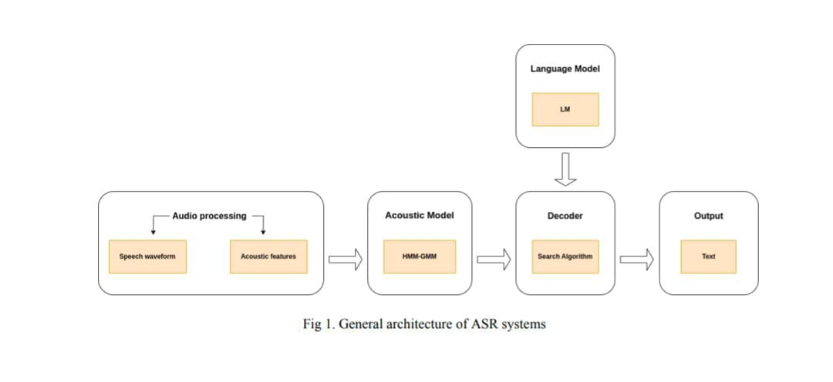
Methodology
ASR algorithms work through three types of modeling: acoustic modeling, language modeling, and pronunciation modeling (Fig.1).
ASR algorithms work through three types of modeling: acoustic modeling, language modeling, and pronunciation modeling

Slide 4
Data and Data-preprocessing
Familiarization with ASR pipeline, kaldi toolkit and datasets.
Assigned Language: Telugu
Format : audio files - “wav”, data.json, params.json
Duration: 50 hours (Training : 45 hours; Testing : 5 hours)
Sampling rate :16000 HZ
Data preparation
Utt2spk
Wav.scp
Text
lexicon.txt -> non_silence_phones.txt and silence_phones.txt

Slide 5
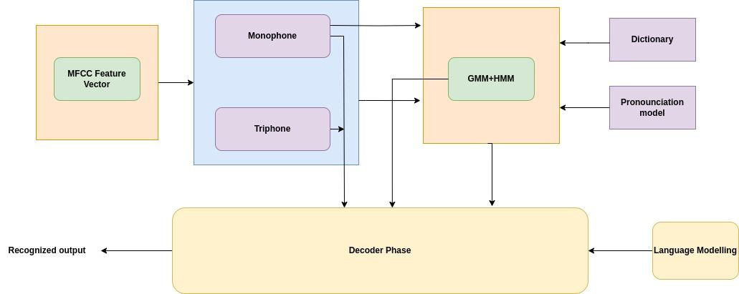
Project workflow

Slide 6
Detailed process
Monophones model phonemes in isolation without considering context. They serve as a foundation for complex models
Forced alignment is performed using a monophone model to align the acoustic features (such as MFCCs) with the corresponding phonetic transcriptions at the monophone level
Triphone training in Kaldi ASR enhances the accuracy of acoustic models by capturing context-dependent phonetic variations, leading to improved speech recognition performance
Forced alignment is then performed again, but this time using the triphone models, which take into account the context in which phonemes occur

Slide 7
Outcomes
Metric used to measure accuracy of ASR models is known as Word Error Rate (WER) that compares the predicted output and the target transcript, word by word to figure out the number of differences between them.
Word Error Rate (WER) for the trained model on entire train data
= 31%

Slide 8
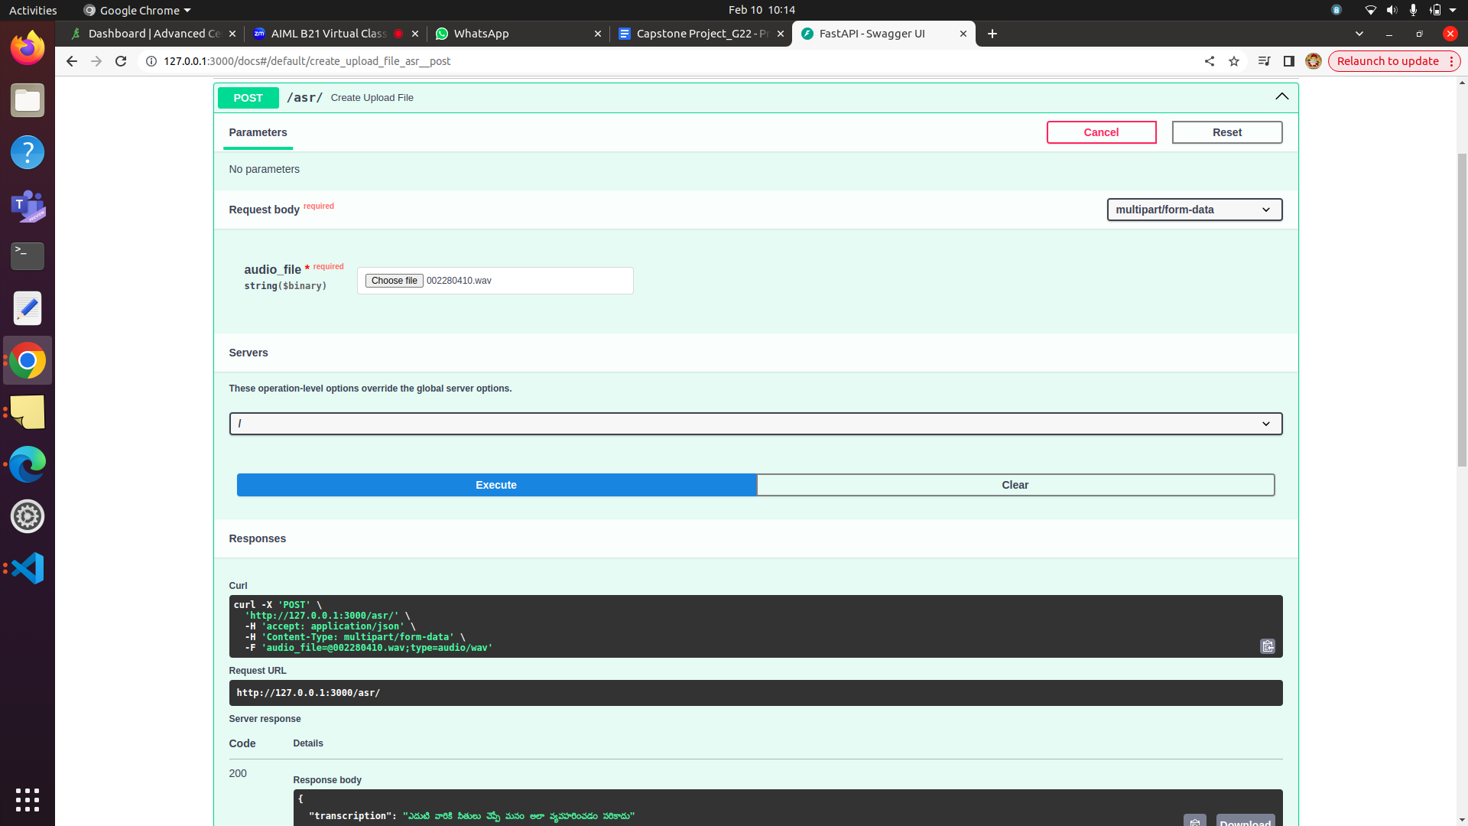
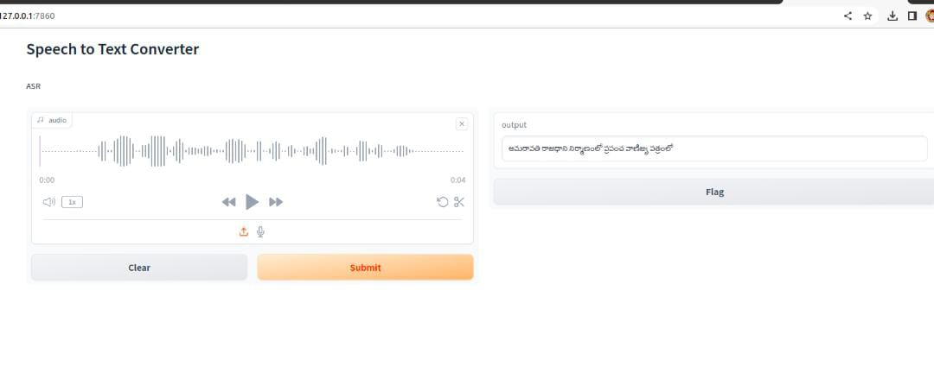
Deployment
We deployed our trained model on two frameworks for user-friendly interactions with the model. The REST API endpoint using Fastapi framework and in-built Swagger UI, enables the user to upload an audio and get the text transcription. whereas, the Gradio interface allows recording a live audio for transcription.
http://127.0.0.1:9000/docs
http://127.0.0.1:7860/

Slide 9
Learnings
End-to-end Training and inference of an ASR model.
Experimental approach in fine tuning ASR model.
Training with various data sizes and quality of data
Adjusting epochs
Deployment of models.
Teamwork and collaboration with effective documentation skills

Slide 10
Challenges and limitations
We faced initial environment setup issues. During Fine tuning task, the processes took long hours limiting our asynchronous experiments as a team. Also, our model struggled with robustness to variabilities such as:
Environment : Type of noise, echo and reverberations, interfering speakers
Transducer : Speech generated from telephone, microphone have varying sampling rates
Speaker characteristics: Speaker age, gender
Speech styles : Accent and speed of speech, continuous or isolated words in speech or tone

Slide 11
Applications
Virtual Assistants
Voice Search
Language Translation
Customer Service and Call Centers
Education
Security and Surveillance

Slide 12
Conclusion
While HMM/GMM models have been foundational in ASR research, they represent an older paradigm compared to newer neural network-based approaches like deep learning. Recent times have seen continuous improvement towards making an ASR Model robust, there are constraints such as high computation power , unavailability of data for spoken languages (or low-resources languages) are some challenging scenarios. However, modern techniques like self-supervised pre-training and fine tuning can boost the speech recognition domain and open up a world of possibilities for voice assistants and chatbots.

Slide 13
Thank you!

